Slide 1
High performance scientific computing
Solving sound wave equations using FDTD
By :
Elie Azoury

Slide 2
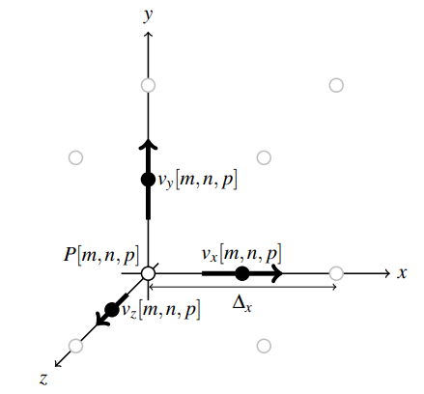
FDTD update equations
In this project it will be assumed:
that the spatial grid offsets are equal in all directions, i.e. ∆x = ∆y = ∆z = δ
the pressure nodes are assumed to be offset by half of a temporal step ∆t from the velocity nodes

Slide 3
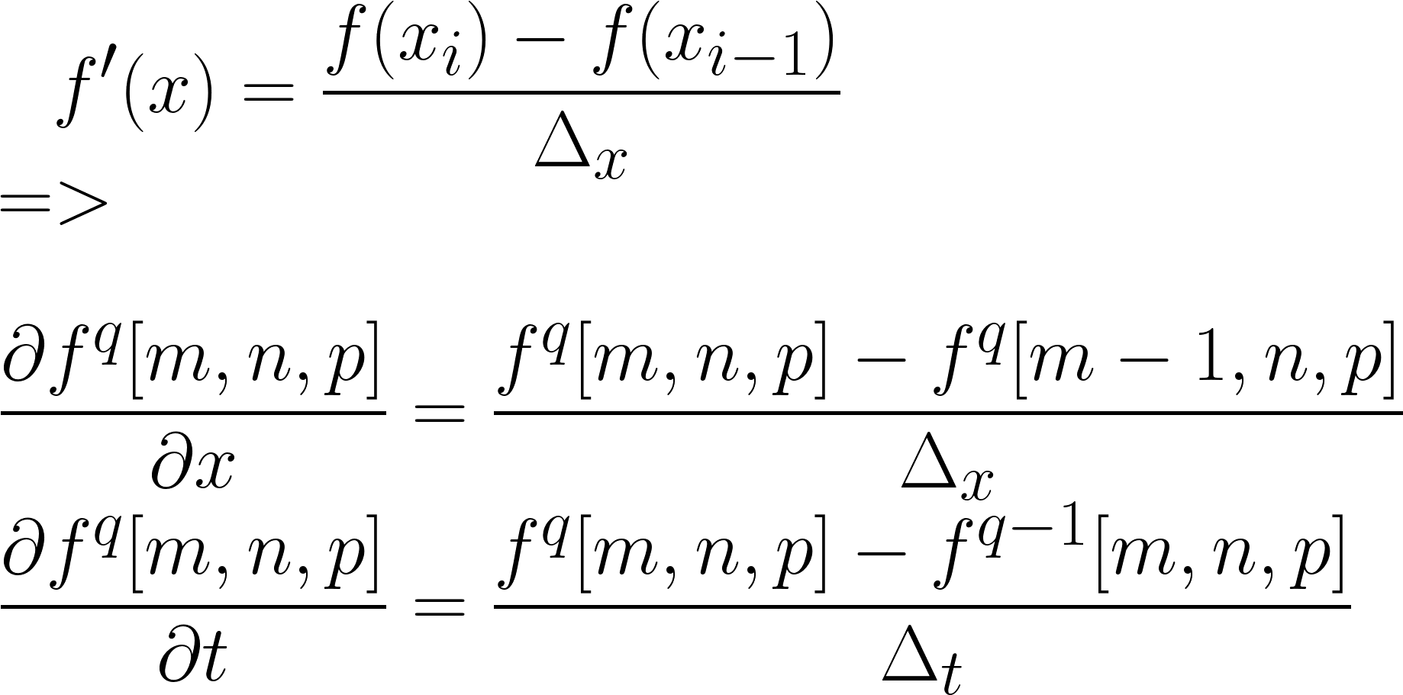
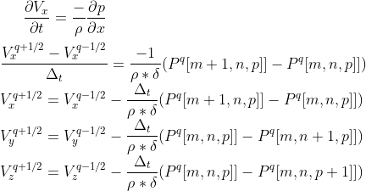
FDTD update equations

Slide 4
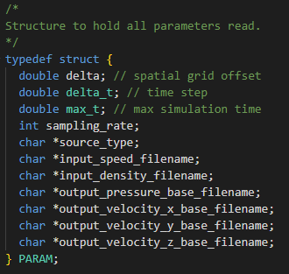
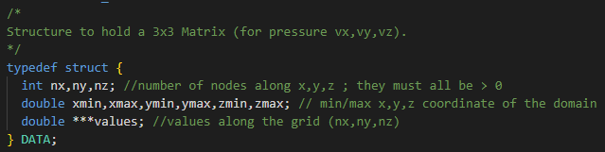
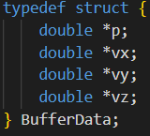
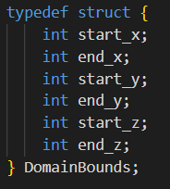
Implementation
Structures definition
3-D array
Stores a space of nodes for speed or pressure
- Stores all parameters
For root gathering and printing
For clean code/ reduce number of parameters

Slide 5
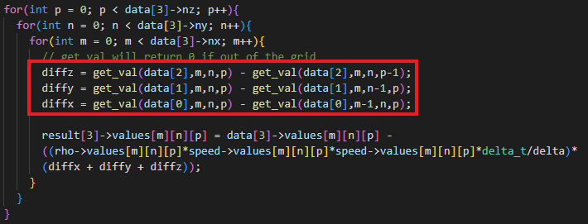
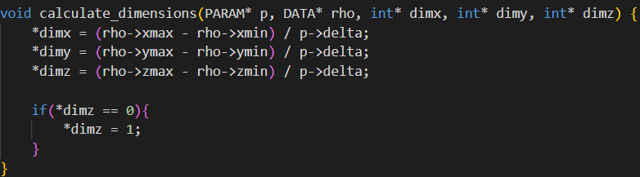
Implementation
Boundary conditions
get_val returns the value at node m,n,p or 0 if the value is not in the domain
It is used to set speeds at 0 outside the domain
Dimesnsion of the simulation depends on delta

Slide 6
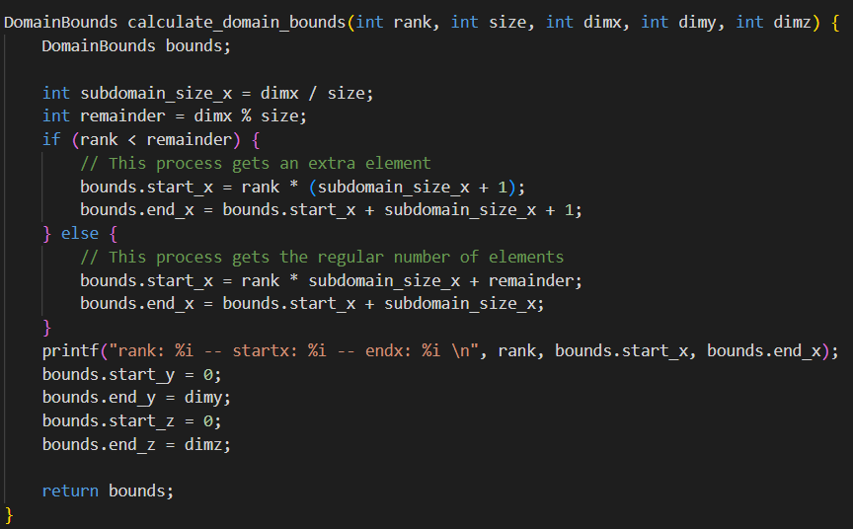
Implementation
Dimension can sometime not be divisible by the number of processors
Let Some of the processors take the remaining domain to handle
Unbalanced data but better performance

Slide 7
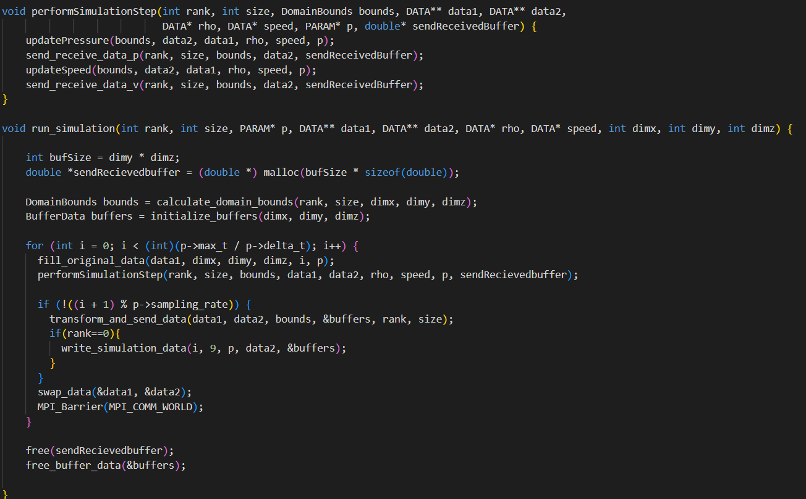
Implementation

Slide 8
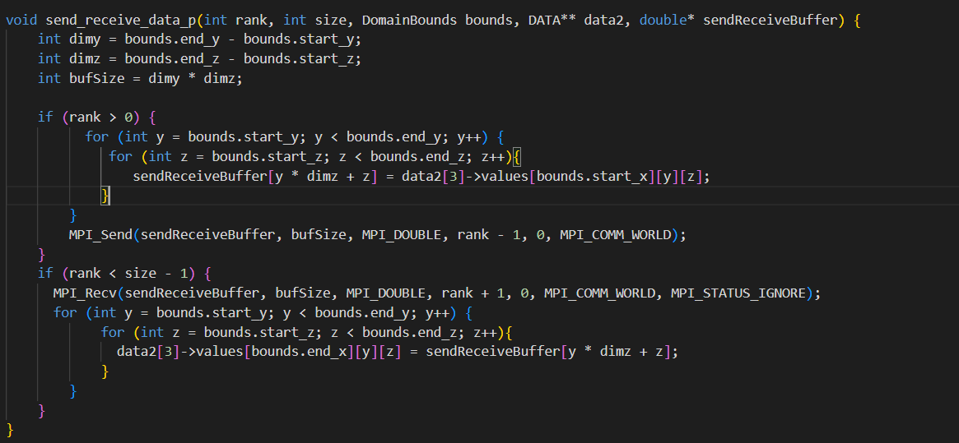
Implementation
At rank >0 transform lower boundary data to send into 1D array and send the buffer to rank -1
At rank < max rank retrieve and store the 1D buffer

Slide 9
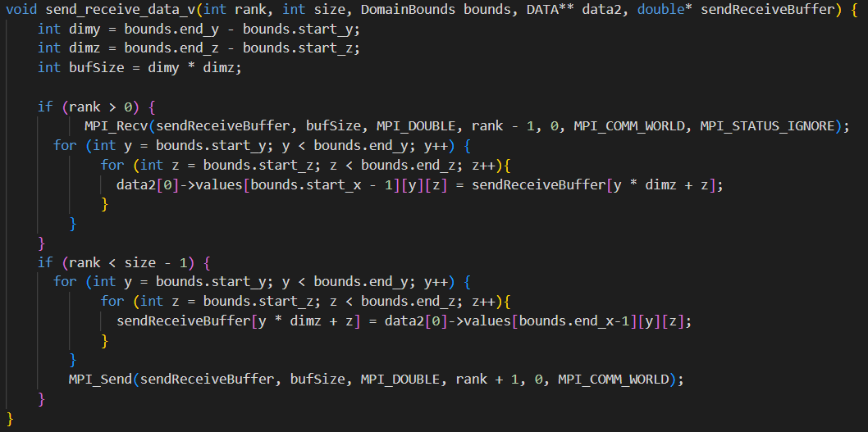
Implementation

Slide 10
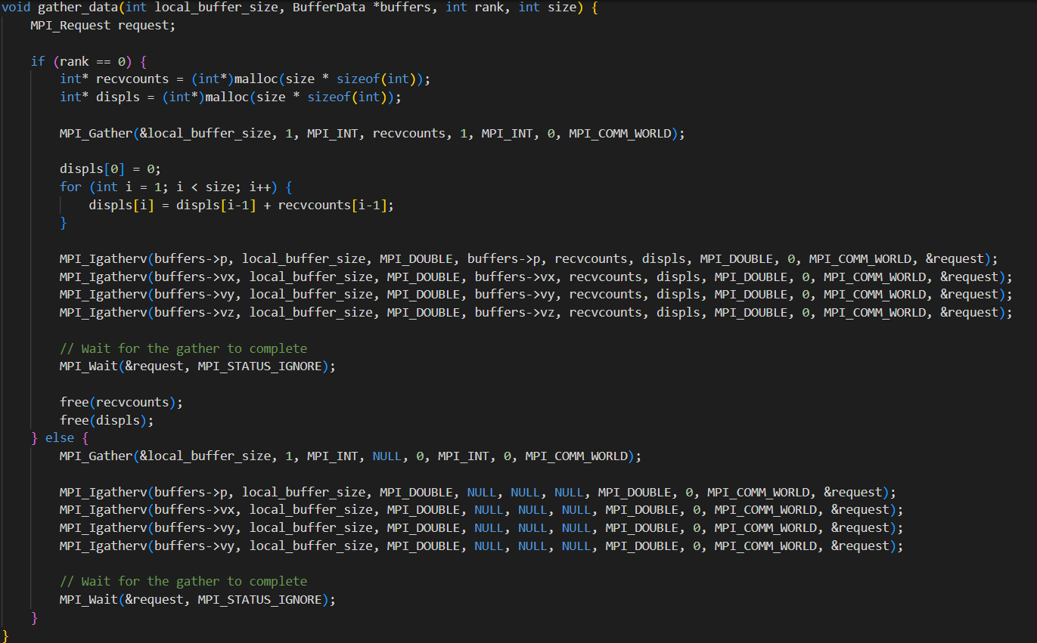
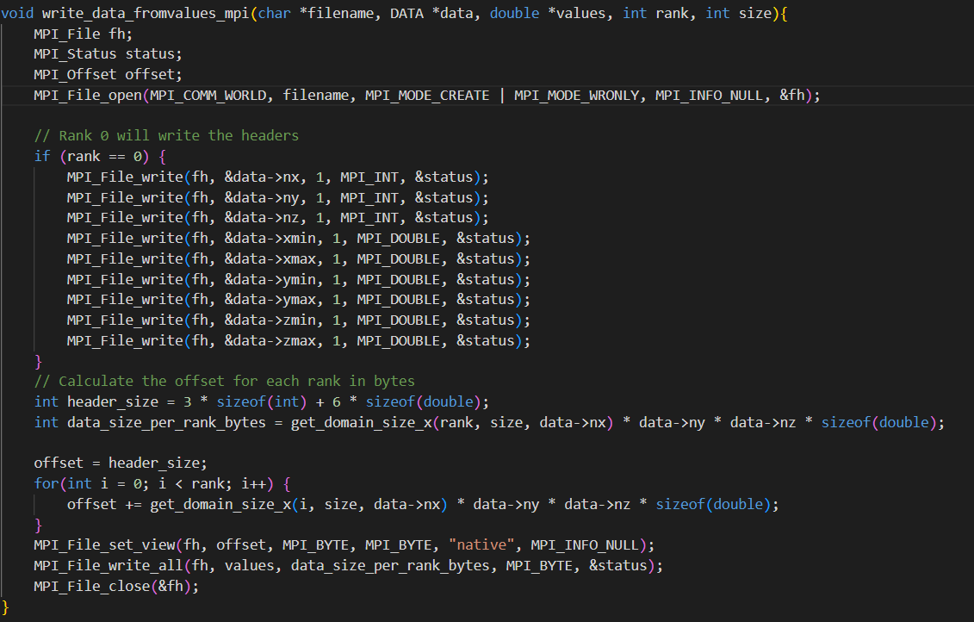
Implementation: How to print?
All ranks transform their calculated data to 1 D buffers (buffervx, buffervy…)
Send these buffers 0 via MPI_Gather
Only rank 0 is in charge of printing.
Using MPI File write
For some reasons speedup deteriorated

Slide 11
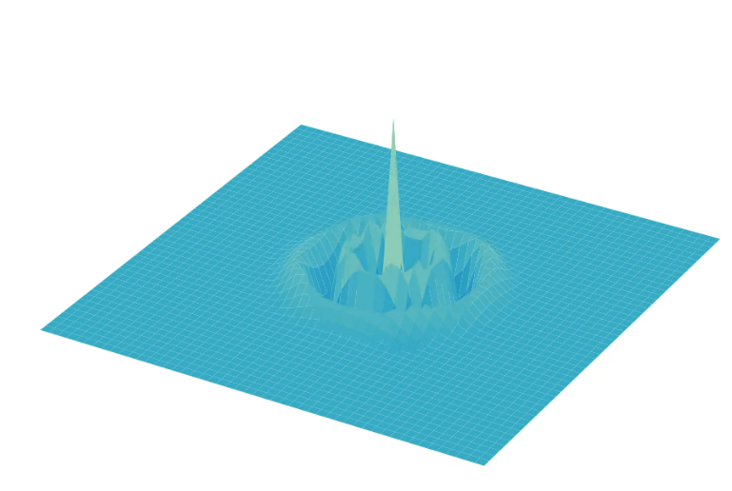
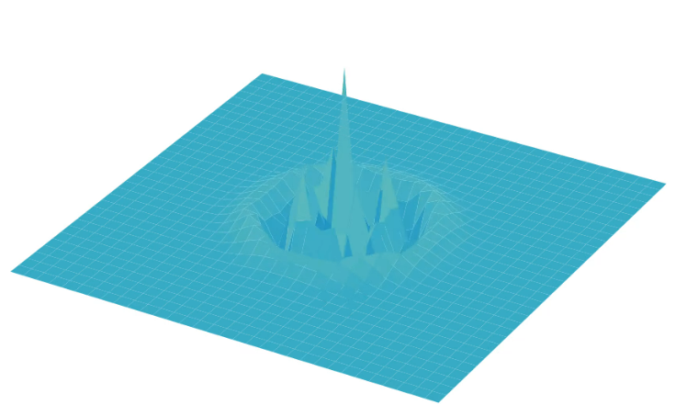
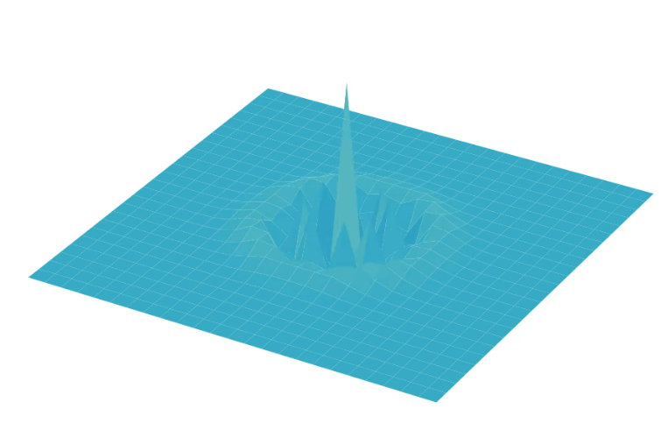
Stability of the scheme depending on the ratio c* Δ(t)/δ.
C is fixed, tried first reducing and augmenting delta.
Quality detoriarate the further we augment delta
δ = 2*10^(-2)
δ = 3*10^(-2)
δ = 4*10^(-2)

Slide 12
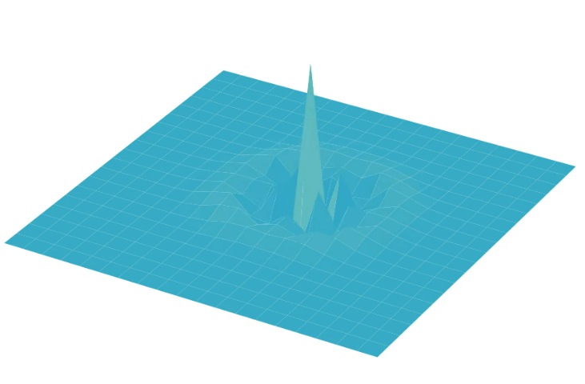
Stability of the scheme depending on the ratio c* Δ(t)/δ.
Δ = 5*10^(-2)

Slide 13
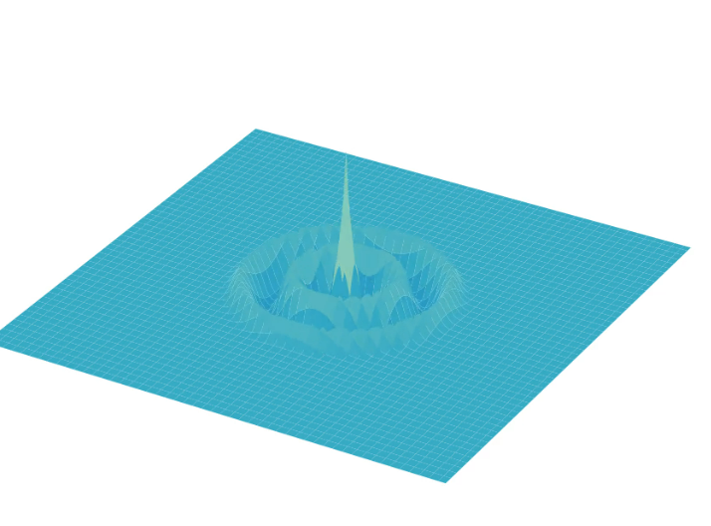
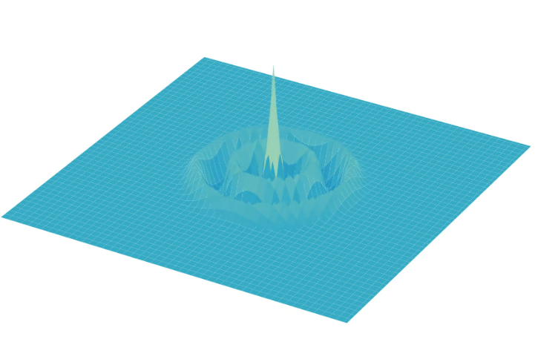
Stability of the scheme depending on the ratio c* Δ(t)/δ.
Reducing delta less than 1*10^(-6) does not change scheme it becomes more stable
δ = 1*10^(-2)
δ = 0.5*10^(-2)

Slide 14
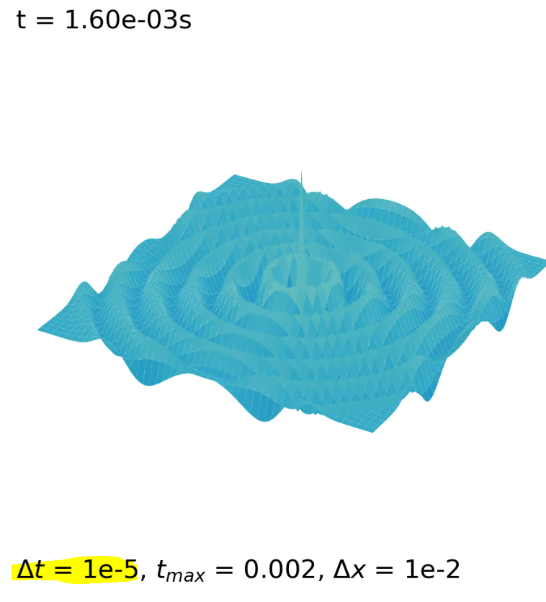
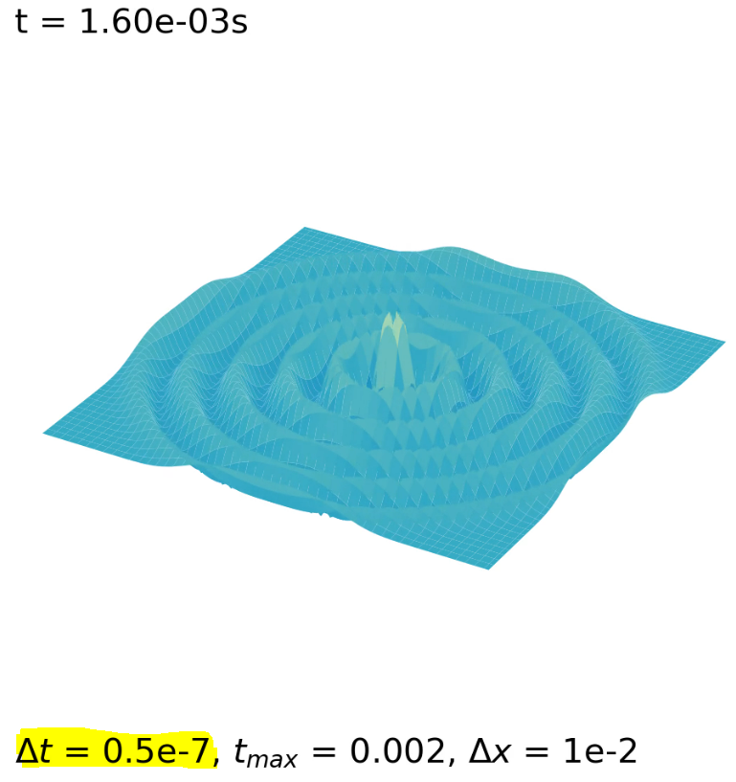
Stability of the scheme depending on the ratio c* Δ(t)/δ
What about fixing δ and varying Δt?
I tried augmenting Δt which end up having the same video but with lower frame
I also reducing Δt all the way to 10^-8s which gave the same result with a way more longer video
(more frames)

Slide 15
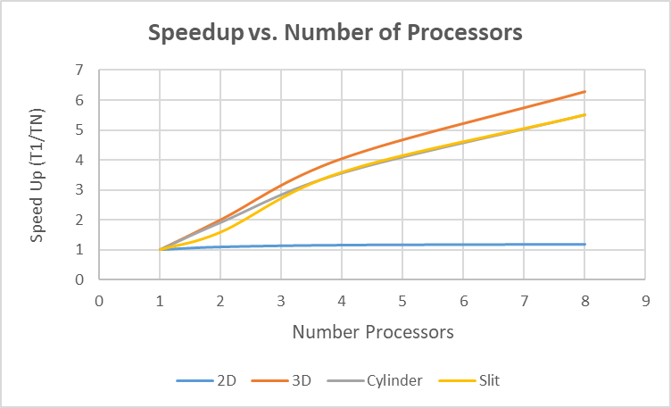
Scalability analysis: Strong Scaling
In an ideal scaling: Speedup = N
Limit: Amdahl’s law
speedup = 1 / (s + p / N)
Dimension of the simulation is fixed and we increase number of processors
Done to see how much problem will run faster

Slide 16
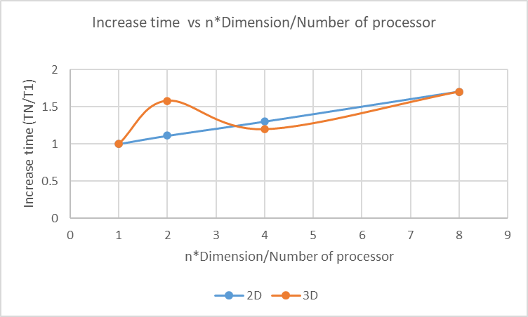
Scalability analysis: Weak Scaling
When we increase the problem size, we proportionally increase the number of processes
If we double dimx => We double number of processors
Ideally, we should not see an increase in the time taken to solve the problem

Slide 17
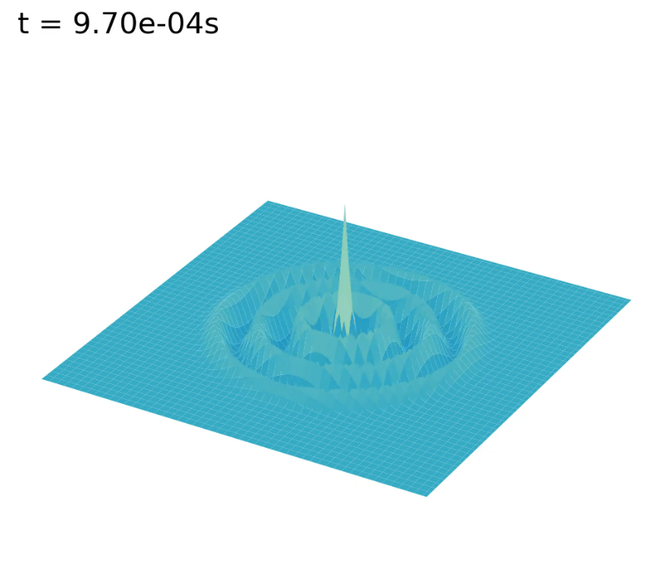
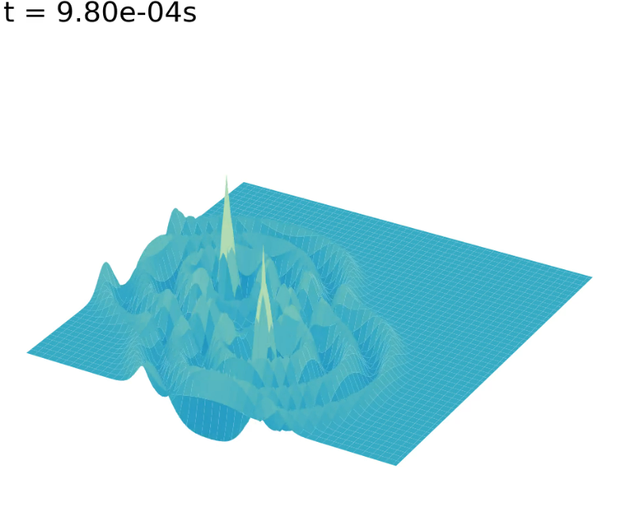
Interesting Configurations
One source at dimx/2, dimy/2
2 sources at dimx/2, dimy/4 et dimx/4,dimy/2

Slide 18
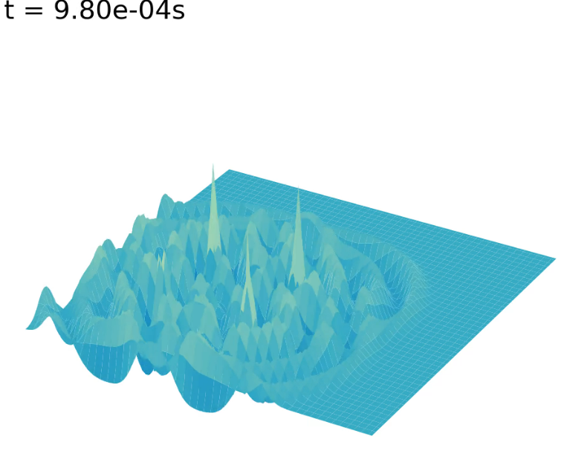
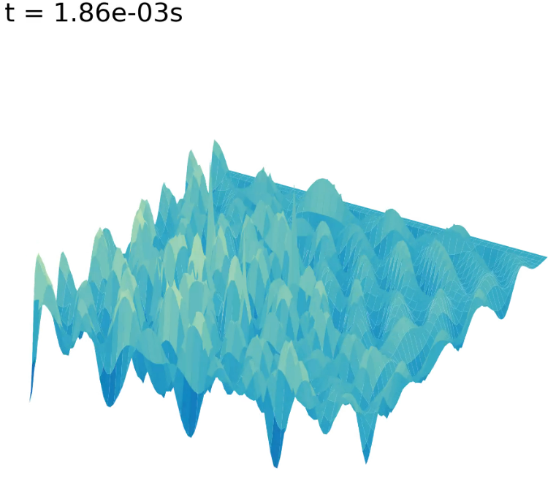
Interesting Configurations(2)
4 sources:
dimx/2, dimy/4
dimx/4,dimy/2
dimx/2, dimy/2
dimx/4, dimy/4

Slide 19
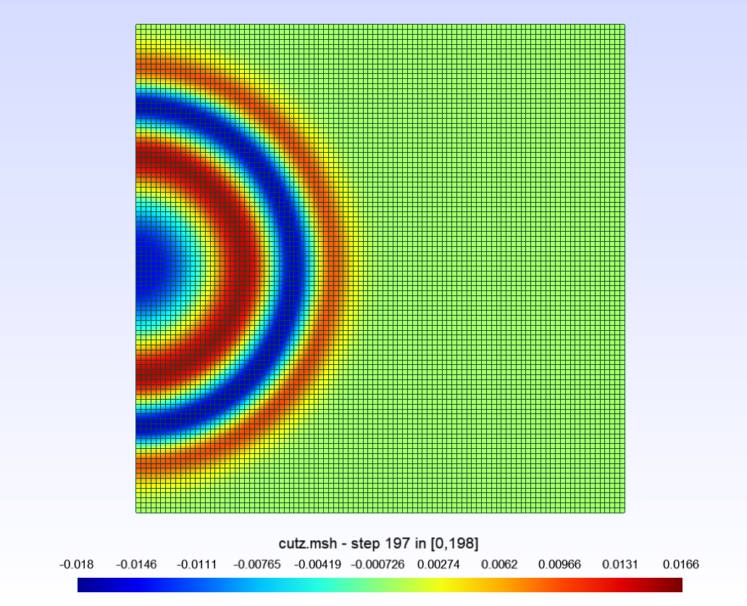
Using Gmsh
Cutz for all output_p

